Slide 1
Near Real-time Log Analysis
Background
Analyse server log data in near-real-time for operational purposes.
Objectives
Near real time log data for operational purposes in case we do experience a surge that might be linked to an attack.

Slide 2
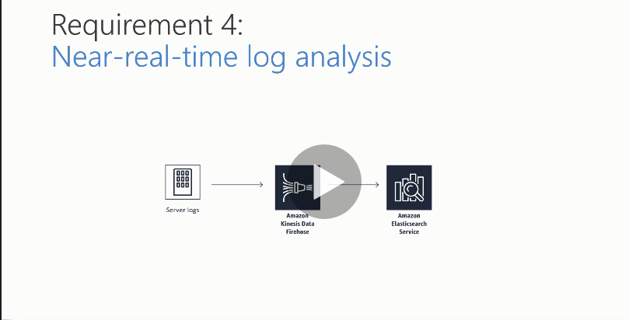
Design Solution Blueprint

Slide 3
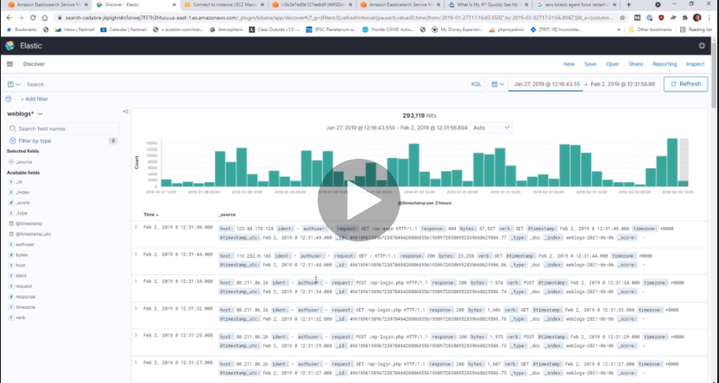
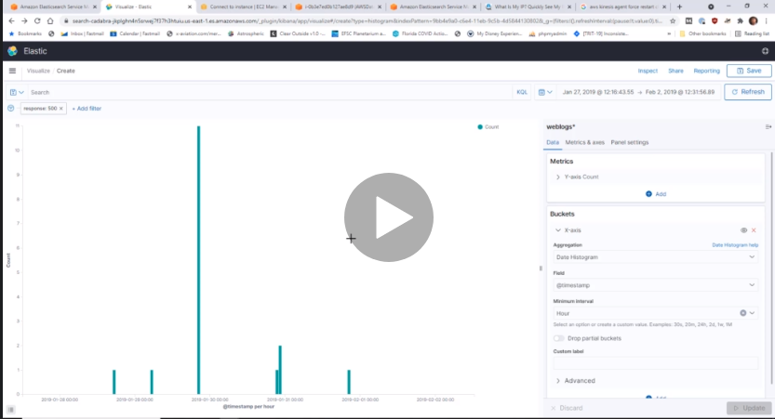
Data Visualization in Kibana

Slide 4
Process
Mechanics
Simulate and get some weblog data from an EC2 instance (Using real Apache http logs in this case – Imagine you are running a website on an EC2 instance that is going to be dumping server logs into Amazon Kinesis Firehose). Kinesis agent will trigger the datalog flow.
Create a Kinesis Firehose delivery stream that will then pump Apache log directly into Amazon Elastisearch service (Development in 1 availability zone) where we can query and filter the data. Transform the data using AWS Lamda function in Kinesis Firehole from CSV format to JSON.
An application Kinesis –Firehose -Apache –CSV –JSON lambda function will be set up automatically usin Cloudformation with IAM roles.
Query the log data and interactively build dashboards and visualizations for it using Kibana.

Slide 5
Security
Give Kibana access via your IP address of wherever your log data is coming from.
Create a new IAM role for the Kinesis Firehose delivery stream
Also Create an IAM role that will give Kinesis Firehole access to Elastisearch

